Slide 1
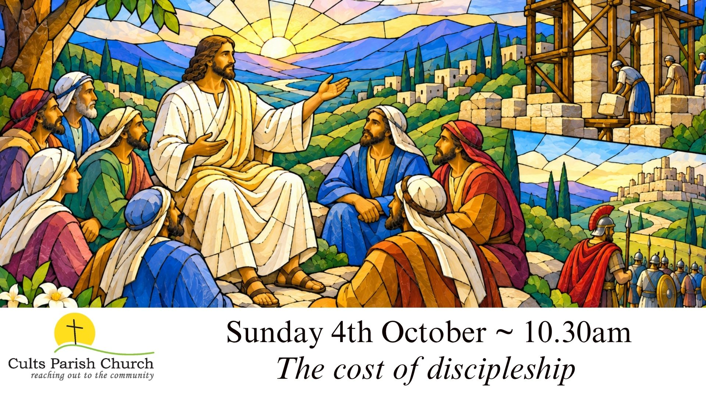

Slide 2
Our services are ‘live-streamed’, please
let us know if you wish a ‘camera-shy’ seat.

Slide 3
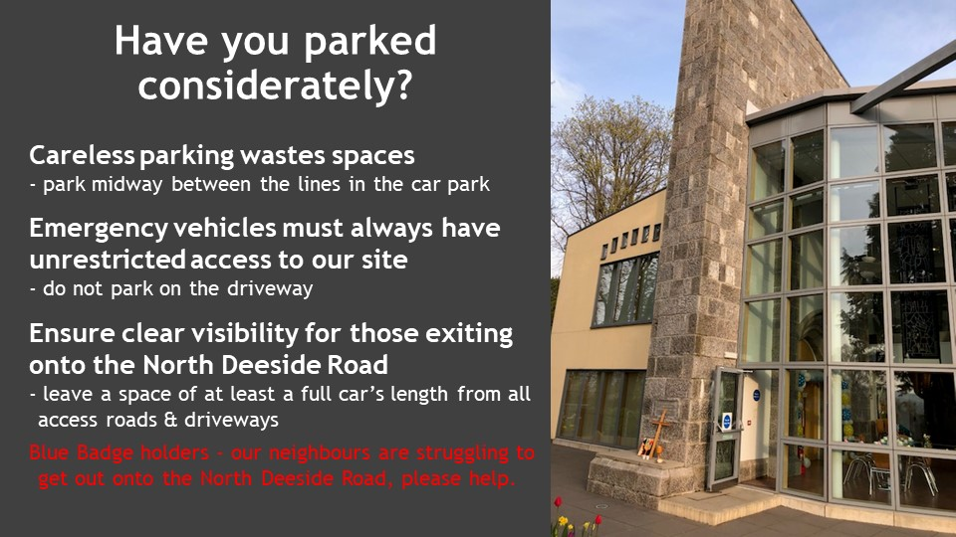
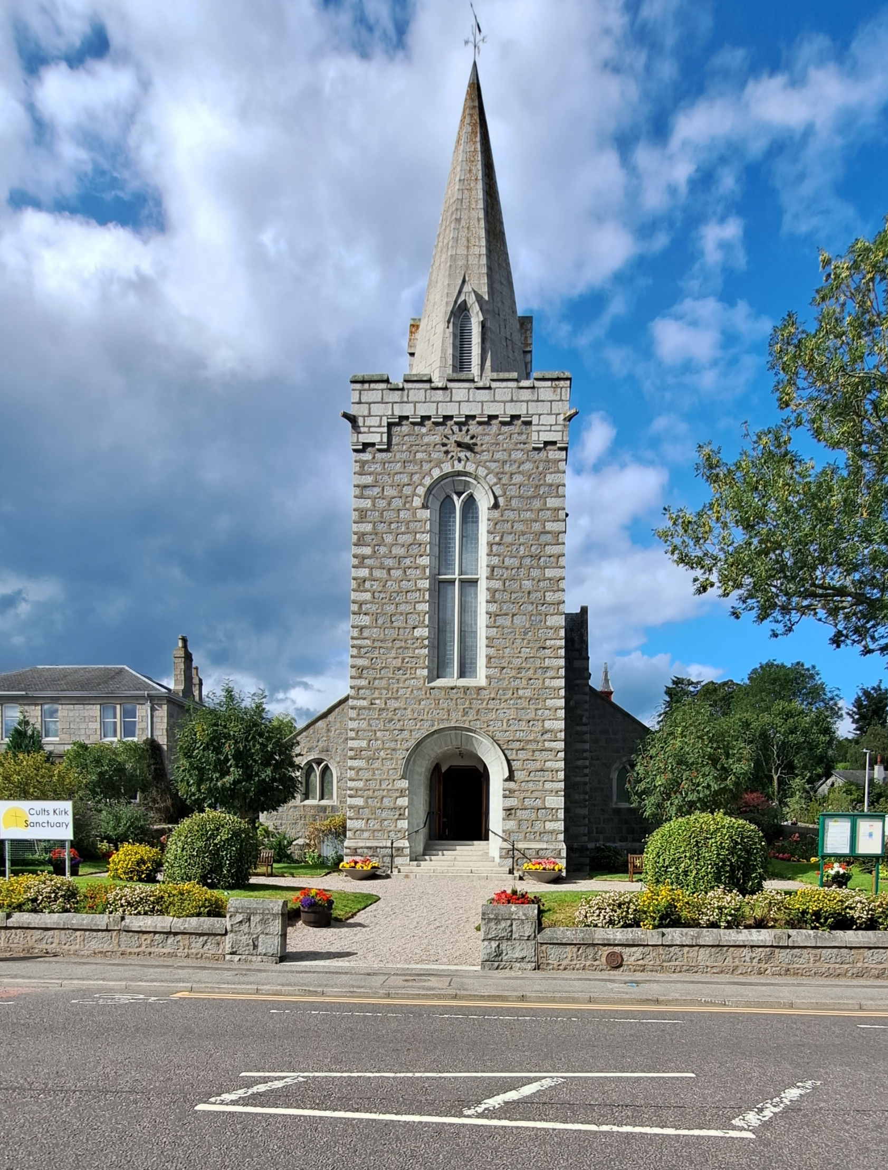
Careless parking wastes spaces
Emergency vehicles must always have unrestricted passage – do not park on the east side of Quarry Road
Ensure clear visibility for those exiting onto North Deeside Road
  - leave a space of at least a full car’s length from all access roads and driveways
This applies to Blue Badge holders too.

Slide 4

What’s On?.......
Sunday
  Main Service 10:30am
Monday
  Lunch Club: 12-2pm in the Kirk Centre. Book with Jackie Hatchwell.
  Badminton Club: 7.15pm (Main Hall, Quarry Rd)
Tuesday
  Hub Café is open from 10:00-14:00
  (cakes, coffee, soup, sandwiches, paninis)
  Bridge, Scrabble, etc. 10:00-12:00 (upstairs in Morven & Scolty)

Slide 5
What’s On?.......
Wednesday
  Hub Café is open from 10:00-14:00
  O50 group meet from 13:30-15:00
    7th Sept ‘It’s Braw’ – Minnie Kaur
    14th Sept The Castlegate Revisited - Alec Urquhart
Thursday
  Hub Café is open from 10:00-14:00
  Baby and Toddlers – 9:30 to 11:30am Main Hall, Quarry Road
  Bible Study: Scolty (CKC), coffee & fellowship from 10am.
Friday
  Friday Café for S1-6 after school until 5:30pm
  Folk at the Hub – 7:30pm Cults Kirk centre

Slide 6
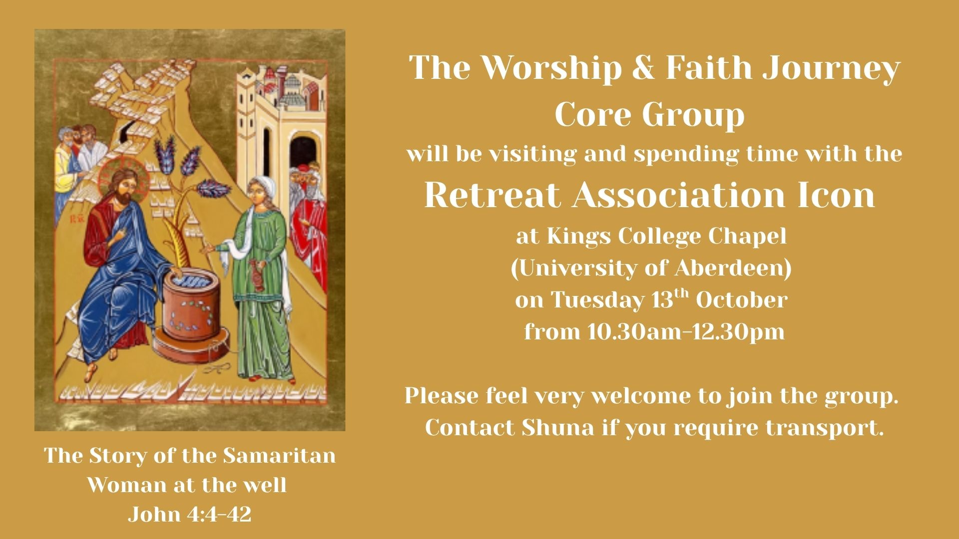

Slide 7

Tuesday 6th October, ‘Operation Hope Egypt’ - James Fraser
2pm Cults Kirk Centre (Lochnagar) - All Welcome.
PROJECT PARTNERS FOR 2025-2027
Bibles for Bairns
“to provide bibles to young children in Scotland in conjunction with the Scottish Bible Society,.”
Bear Necessities
“helping to plant a Church in Bulgaria.”
Operation Hope
“supporting Christians in Egypt, working with Release International.
Playful Beginnings
“working with Crossreach to support vulnerable families in Scotland”

Slide 8
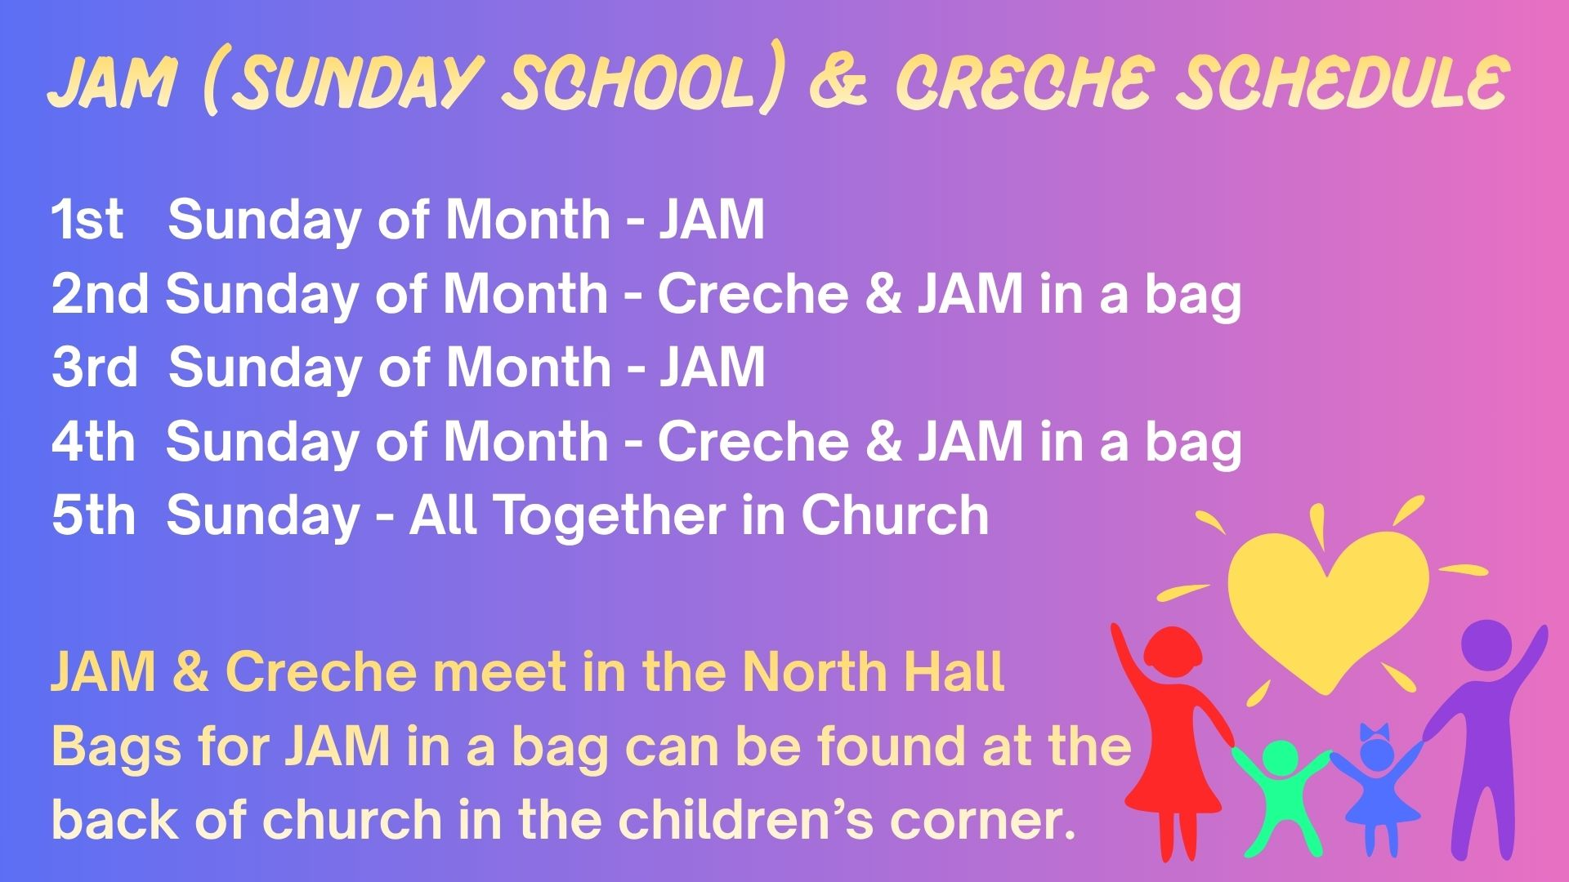

Slide 9


Slide 10


Slide 11


Slide 12

Cults Music to Remember
“Cults Music to Remember” is a monthly singing group for people with dementia, those who support them and anyone else who enjoys singing and would like some company. We sing well known songs, have fun, a cup of tea and chat together.
Sessions:-
Tuesday 13th October 2026
Tuesday 10th November 2026 Tuesday 8th December 2026
Where: Cults Kirk Centre (Lochnagar)
404 North Deeside Road, Cults, AB15 9TD
Time: 2.00pm-3.30pm (including refreshments)

Slide 13
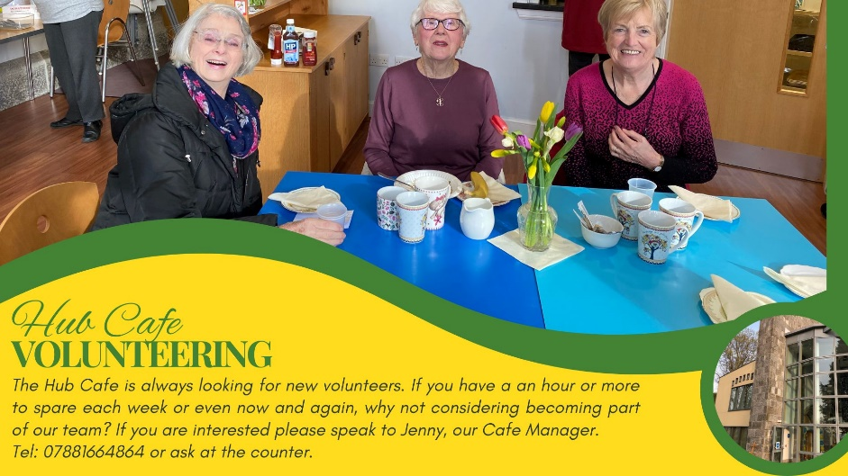


Slide 14

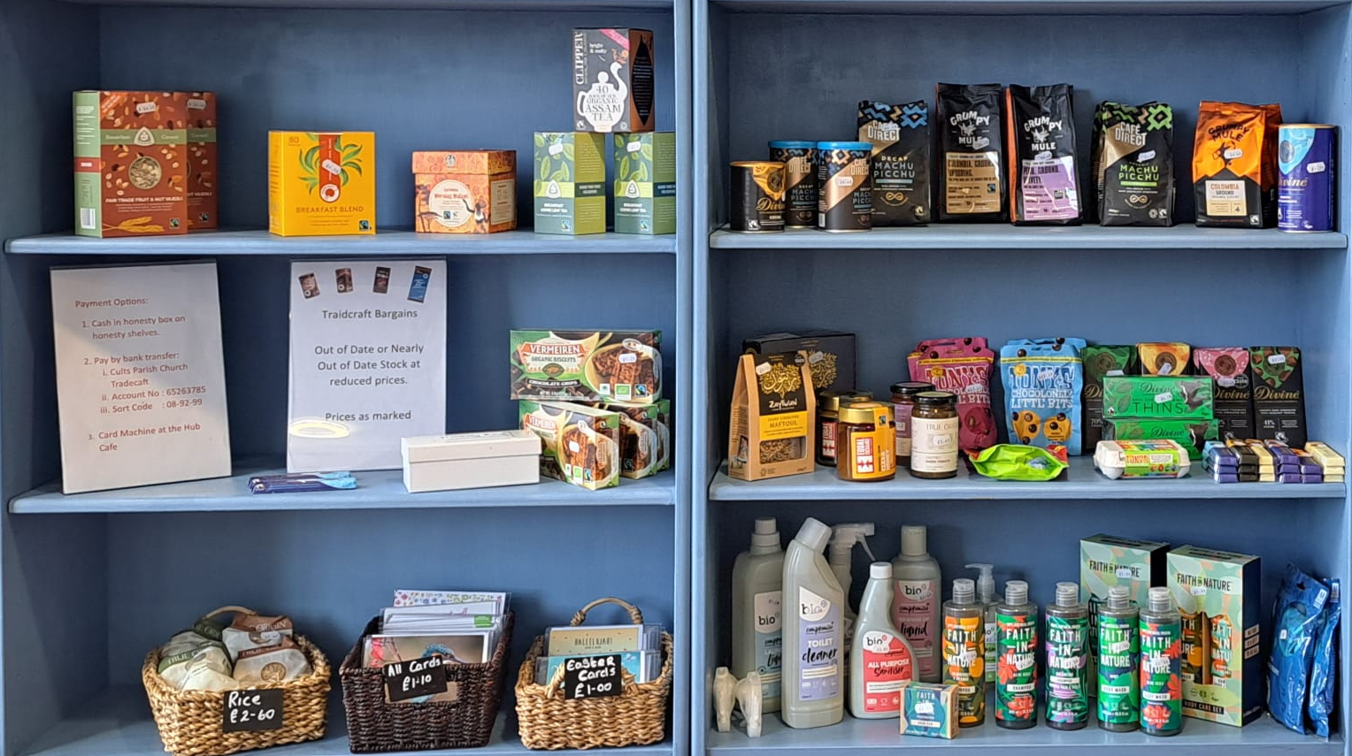
Available from the Kirk Centre

Slide 16
Our services are ‘live-streamed’, please
let us know if you wish a ‘camera-shy’ seat.

Slide 17
If you believe and I believe
CH4 771
Zimbabwean traditional song
based on Matthew 18: 19

Slide 18
If you believe and I believe
and we together pray,
the Holy Spirit shall come down
and set God's people free,
and set God's people free,
and set God's people free,
the Holy Spirit shall come down
and set God's people free.
Reprinted/Streamed:
© Church Copyright License No 62724
Streaming Licence No 131076

Slide 19
In Christ we live and in Christ we die
GWA 204
John L. Bell (b. 1949, Scotland)

Slide 20
In Christ we live and in Christ we die
and in Christ we rise up again.
Let heaven be glad and let earth rejoice
and sing, 'Alleluia, amen!'

Slide 21
This is God's house, holy ground for God's people,
hallowed by singing and silence and prayer;
blessed by the presence and power of the Spirit,
founded on faith in the Saviour we share.

Slide 22
In Christ we live and in Christ we die
and in Christ we rise up again.
Let heaven be glad and let earth rejoice
and sing, 'Alleluia, amen!'

Slide 23
This is the place where the Church as Christ's body
meets as a family where all have their place:
stalwart and stranger, speaker and seeker –
each needs the others and all need God's grace.

Slide 24
In Christ we live and in Christ we die
and in Christ we rise up again.
Let heaven be glad and let earth rejoice
and sing, 'Alleluia, amen!'

Slide 25
This is the time when desires and intentions
find interaction with God's holy word:
trouble and treasure, business and pleasure,
all are redeemed and restored by the Lord.

Slide 26
In Christ we live and in Christ we die
and in Christ we rise up again.
Let heaven be glad and let earth rejoice
and sing, 'Alleluia, amen!'

Slide 27
This is the purpose of God in creation:
all shall be changed for the gospel is true –
illness to healing, coldness to caring,
doubt to commitment and old into new.

Slide 28
In Christ we live and in Christ we die
and in Christ we rise up again.
Let heaven be glad and let earth rejoice
and sing, 'Alleluia, amen!'
Reprinted/streamed:
OneLicense #A-742908

Slide 29
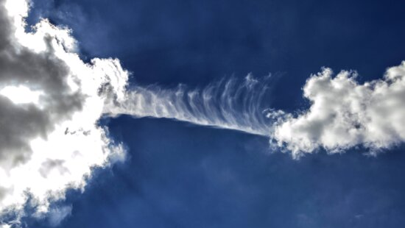
Our Father, who art in heaven,
hallowed be thy name;
thy kingdom come;
thy will be done;
on earth as it is in heaven.

Slide 30
Give us this day our daily bread.
And forgive us our debts,
as we forgive our debtors.
And lead us not into temptation;
but deliver us from evil.

Slide 31
For thine is the kingdom,
and the power,
and the glory, forever.
Amen.

Slide 32
Give me oil in my lamp,
keep me burning
Anon

Slide 33
Give me oil in my lamp, keep me burning,
give me oil in my lamp, I pray;
give me oil in my lamp, keep me burning,
keep me burning till the break of day.

Slide 34
Sing hosanna, sing hosanna,
sing hosanna to the King of kings!
Sing hosanna, sing hosanna,
sing hosanna to the King.

Slide 35
Make me a fisher of men, keep me seeking,
make me a fisher of men, I pray;
make me a fisher of men, keep me seeking,
keep me seeking till the break of day.

Slide 36
Sing hosanna, sing hosanna,
sing hosanna to the King of kings!
Sing hosanna, sing hosanna,
sing hosanna to the King.

Slide 37
Give me joy in my heart, keep me singing,
give me joy in my heart, I pray;
give me joy in my heart, keep me singing,
keep me singing till the break of day.

Slide 38
Sing hosanna, sing hosanna,
sing hosanna to the King of kings!
Sing hosanna, sing hosanna,
sing hosanna to the King.

Slide 39
Give me love in my heart, keep me serving,
give me love in my heart, I pray;
give me love in my heart, keep me serving,
keep me serving till the break of day.

Slide 40
Sing hosanna, sing hosanna,
sing hosanna to the King of kings!
Sing hosanna, sing hosanna,
sing hosanna to the King.
Reprinted/Streamed:
“Public Domain”

Slide 41
Luke 14:25-35 (GNT)
The Cost of Being a Disciple
²⁵ Once when large crowds of people were going along with Jesus, he turned and said to them, ²⁶ “Those who come to me cannot be my disciples unless they love me more than they love father and mother, wife and children, brothers and sisters, and themselves as well. ²⁷ Those who do not carry their own cross

Slide 42
and come after me cannot be my disciples. ²⁸ If one of you is planning to build a tower, you sit down first and figure out what it will cost, to see if you have enough money to finish the job. ²⁹ If you don't, you will not be able to finish the tower after laying the foundation; and all who see what happened will make fun of you. ³⁰ ‘You began to build but can't finish the job!’

Slide 43
they will say. ³¹ If a king goes out with ten thousand men to fight another king who comes against him with twenty thousand men, he will sit down first and decide if he is strong enough to face that other king. ³² If he isn't, he will send messengers to meet the other king to ask for terms of peace while he is still a long way off. ³³ In the same way,” concluded Jesus, “none of you

Slide 44
can be my disciple unless you give up everything you have.
Worthless Salt
³⁴ “Salt is good, but if it loses its saltiness, there is no way to make it salty again. ³⁵ It is no good for the soil or for the manure pile; it is thrown away. Listen, then, if you have ears!”

Slide 45
Colossians 4:2-6 (GNT)
Instructions
² Be persistent in prayer, and keep alert as you pray, giving thanks to God. ³ At the same time pray also for us, so that God will give us a good opportunity to preach his message about the secret of Christ. For that is why I am now in prison. ⁴ Pray, then, that I may speak, as I should, in such a way as to make it clear. ⁵ Be wise in the way you act toward those who are not

Slide 46
believers, making good use of every opportunity you have. ⁶ Your speech should always be pleasant and interesting, and you should know how to give the right answer to everyone.

Slide 47
Lord, speak to me, that I may speak
CH4 542
Frances Ridley Havergal (1836-1879)

Slide 48
Lord, speak to me, that I may speak
in living echoes of your tone;
as you have sought, so let me seek
your erring children lost and lone.

Slide 49
O lead me, Lord, that I may lead
the wandering and the wavering feet;
O feed me, Lord, that I may feed
your hungering ones with manna sweet.

Slide 50
O strengthen me, that, while I stand
firm on the rock, secure and free,
I may stretch out a loving hand
to wrestlers with the troubled sea.

Slide 51
O teach me, Lord, that I may teach
the precious things which you impart;
and wing words, that they may reach
the hidden depths of many a heart.

Slide 52
O fill me with your fullness, Lord,
until my very heart o'erflow
in kindling thought and glowing word,
your love to tell, your praise to show.

Slide 53
O use me, Lord, use even me,
just as you will, and when, and where,
until at last your face I see,
your rest, your joy, your glory share.
Reprinted/Streamed:
“Public Domain”

Slide 54
Lord, you have come to the seashore
CH4 532
Cesáreo Gabaráin (1936-1991)
translated Robert Trupia

Slide 55
Lord, you have come to the seashore,
neither searching for the rich nor the wise,
desiring only that I should follow.
O Lord, with your eyes set upon me,
gently smiling, you have spoken my name.
All I longed for I have found by the water,
at your side I will seek other shores.

Slide 56
Lord, see my goods, my possessions;
in my boat you find no power, no wealth.
Will you accept, then, my nets and labour?
O Lord, with your eyes set upon me,
gently smiling, you have spoken my name.
All I longed for I have found by the water,
at your side I will seek other shores.

Slide 57
Lord, take my hands, and direct them.
Help me spend myself in seeking the lost,
returning love for the love you gave me.
O Lord, with your eyes set upon me,
gently smiling, you have spoken my name.
All I longed for I have found by the water,
at your side I will seek other shores.

Slide 58
Lord, as I drift on the waters,
be the resting-place of my restless heart,
my life's companion, my friend and refuge.
O Lord, with your eyes set upon me,
gently smiling, you have spoken my name.
All I longed for I have found by the water,
at your side I will seek other shores.
Reprinted/streamed:
OneLicense #A-742908

Slide 59
Christ is made the sure foundation
CH4 200
7th or 8th century
translated John Mason Neale (1818 - 1866)

Slide 60
Christ is made the sure foundation,
Christ the head and corner-stone,
chosen of the Lord and precious,
binding all the Church in one,
holy Zion's help for ever,
and her confidence alone.

Slide 61
To this temple, where we call you,
come, O Lord of Hosts, today:
with your constant loving-kindness,
hear your servants as they pray,
and your fullest benediction shed
within its walls alway.

Slide 62
Here bestow on all your servants
what they ask of you to gain,
what they gain from you for ever
with the blessèd to retain,
and hereafter in your glory
evermore with you to reign.

Slide 63
Praise and honour to the Father,
praise and honour to the Son,
praise and honour to the Spirit,
ever Three and ever One,
One in might and One in glory
while unending ages run.
Reprinted/Streamed:
“Public Domain”

Slide 64
The peace of the earth be with you
CH4 798
Guatemalan text
translated Christine Carson

Slide 65
The peace of the earth be with you,
the peace of the heavens too;
the peace of the rivers be with you,
the peace of the oceans too.
Deep peace falling over you.
God's peace growing in you.

Slide 66
The peace of the earth be with you,
the peace of the heavens too;
the peace of the rivers be with you,
the peace of the oceans too.
Deep peace falling over you.
God's peace growing in you.
Reprinted/streamed:
OneLicense #A-742908

Slide 67
Thank you for joining us today.

Slide 68
What’s On?.......
Sunday
  Main Service 10:30am
Monday
  Lunch Club: 12-2pm in the Kirk Centre. Book with Jackie Hatchwell.
  Badminton Club: 7.15pm (Main Hall, Quarry Rd)
Tuesday
  Hub Café is open from 10:00-14:00
  (cakes, coffee, soup, sandwiches, paninis)
  Bridge, Scrabble, etc. 10:00-12:00 (upstairs in Morven & Scolty)

Slide 69
What’s On?.......
Wednesday
  Hub Café is open from 10:00-14:00
  O50 group meet from 13:30-15:00
    7th Sept ‘It’s Braw’ – Minnie Kaur
    14th Sept The Castlegate Revisited - Alec Urquhart
Thursday
  Hub Café is open from 10:00-14:00
  Baby and Toddlers – 9:30 to 11:30am Main Hall, Quarry Road
  Bible Study: Scolty (CKC), coffee & fellowship from 10am.
Friday
  Friday Café for S1-6 after school until 5:30pm
  Folk at the Hub – 7:30pm Cults Kirk centre

Slide 71
Tuesday 6th October, ‘Operation Hope Egypt’ - James Fraser
2pm Cults Kirk Centre (Lochnagar) - All Welcome.
PROJECT PARTNERS FOR 2025-2027
Bibles for Bairns
“to provide bibles to young children in Scotland in conjunction with the Scottish Bible Society,.”
Bear Necessities
“helping to plant a Church in Bulgaria.”
Operation Hope
“supporting Christians in Egypt, working with Release International.
Playful Beginnings
“working with Crossreach to support vulnerable families in Scotland”

Slide 76
Cults Music to Remember
“Cults Music to Remember” is a monthly singing group for people with dementia, those who support them and anyone else who enjoys singing and would like some company. We sing well known songs, have fun, a cup of tea and chat together.
Sessions:-
Tuesday 13th October 2026
Tuesday 10th November 2026 Tuesday 8th December 2026
Where: Cults Kirk Centre (Lochnagar)
404 North Deeside Road, Cults, AB15 9TD
Time: 2.00pm-3.30pm (including refreshments)

Slide 78
Available from the Kirk Centre

Slide 79
Thank you for joining us today

